Slide 1
Boosting Algorithm-Regression
Ada Boost
Gradient Boosting
XG Boosting

Slide 2
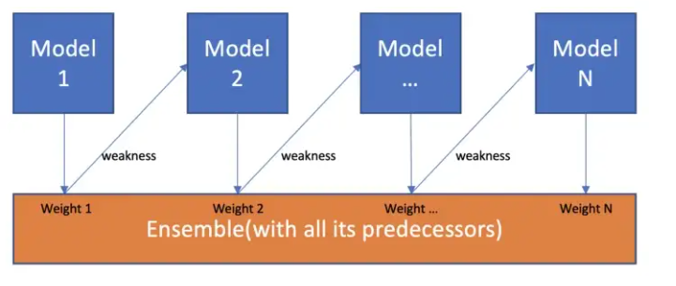
Boosting Algorithm
Boosting algorithms seek to improve the prediction power by training a sequence of weak models, each compensating the weaknesses of its predecessors.

Slide 3
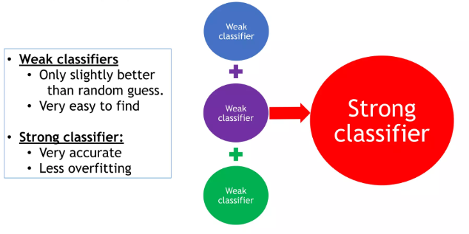
Boosting Algorithm

Slide 4
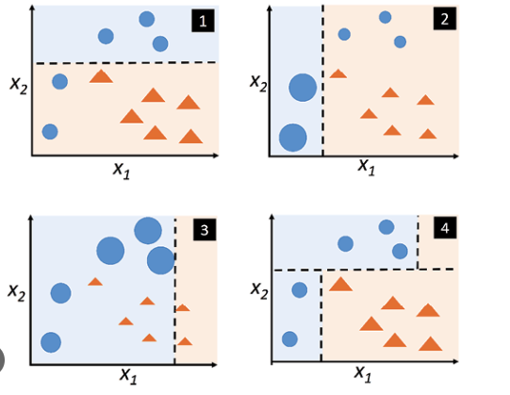
AdaBoost
AdaBoost regressor is a meta-estimator that begins by fitting a regressor on the original dataset and then fits additional copies of the regressor on the same dataset but where the weights of instances are adjusted according to the error of the current prediction.

Slide 5
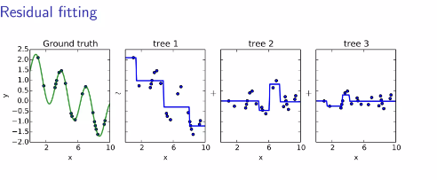
Gradient Boosting
Gradient boosting is one of the variants of ensemble methods where you create multiple weak models and combine them to get better performance as a whole.

Slide 6
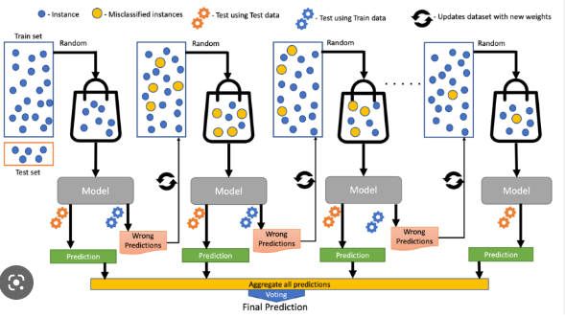
XG Boosting
XGBoost is an efficient implementation of gradient boosting that can be used for regression predictive modeling.
How to fit a final model and use it to make a prediction on new data.

Slide 7
Thank You

